Slide 1
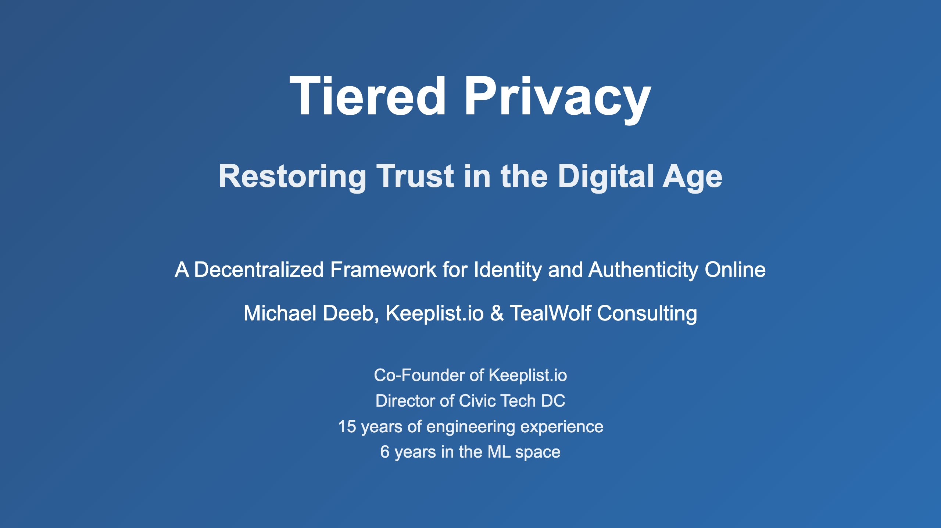

Slide 2
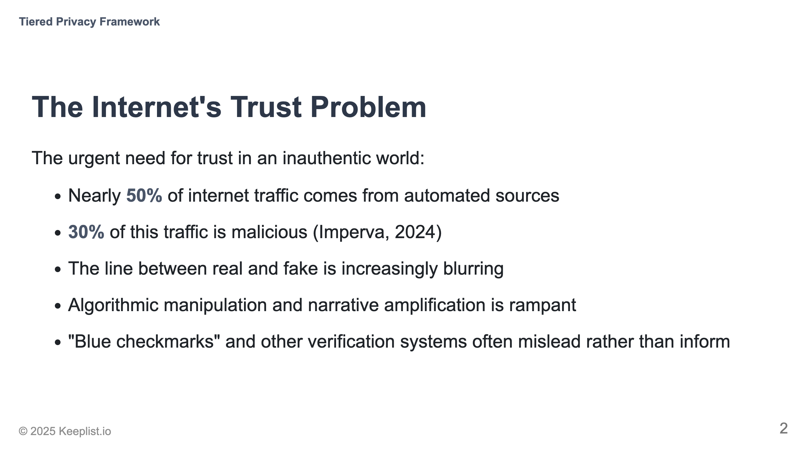
Notes:
Speaker notes Mention the $78 billion lost to identity theft in 2023 alone

Slide 3
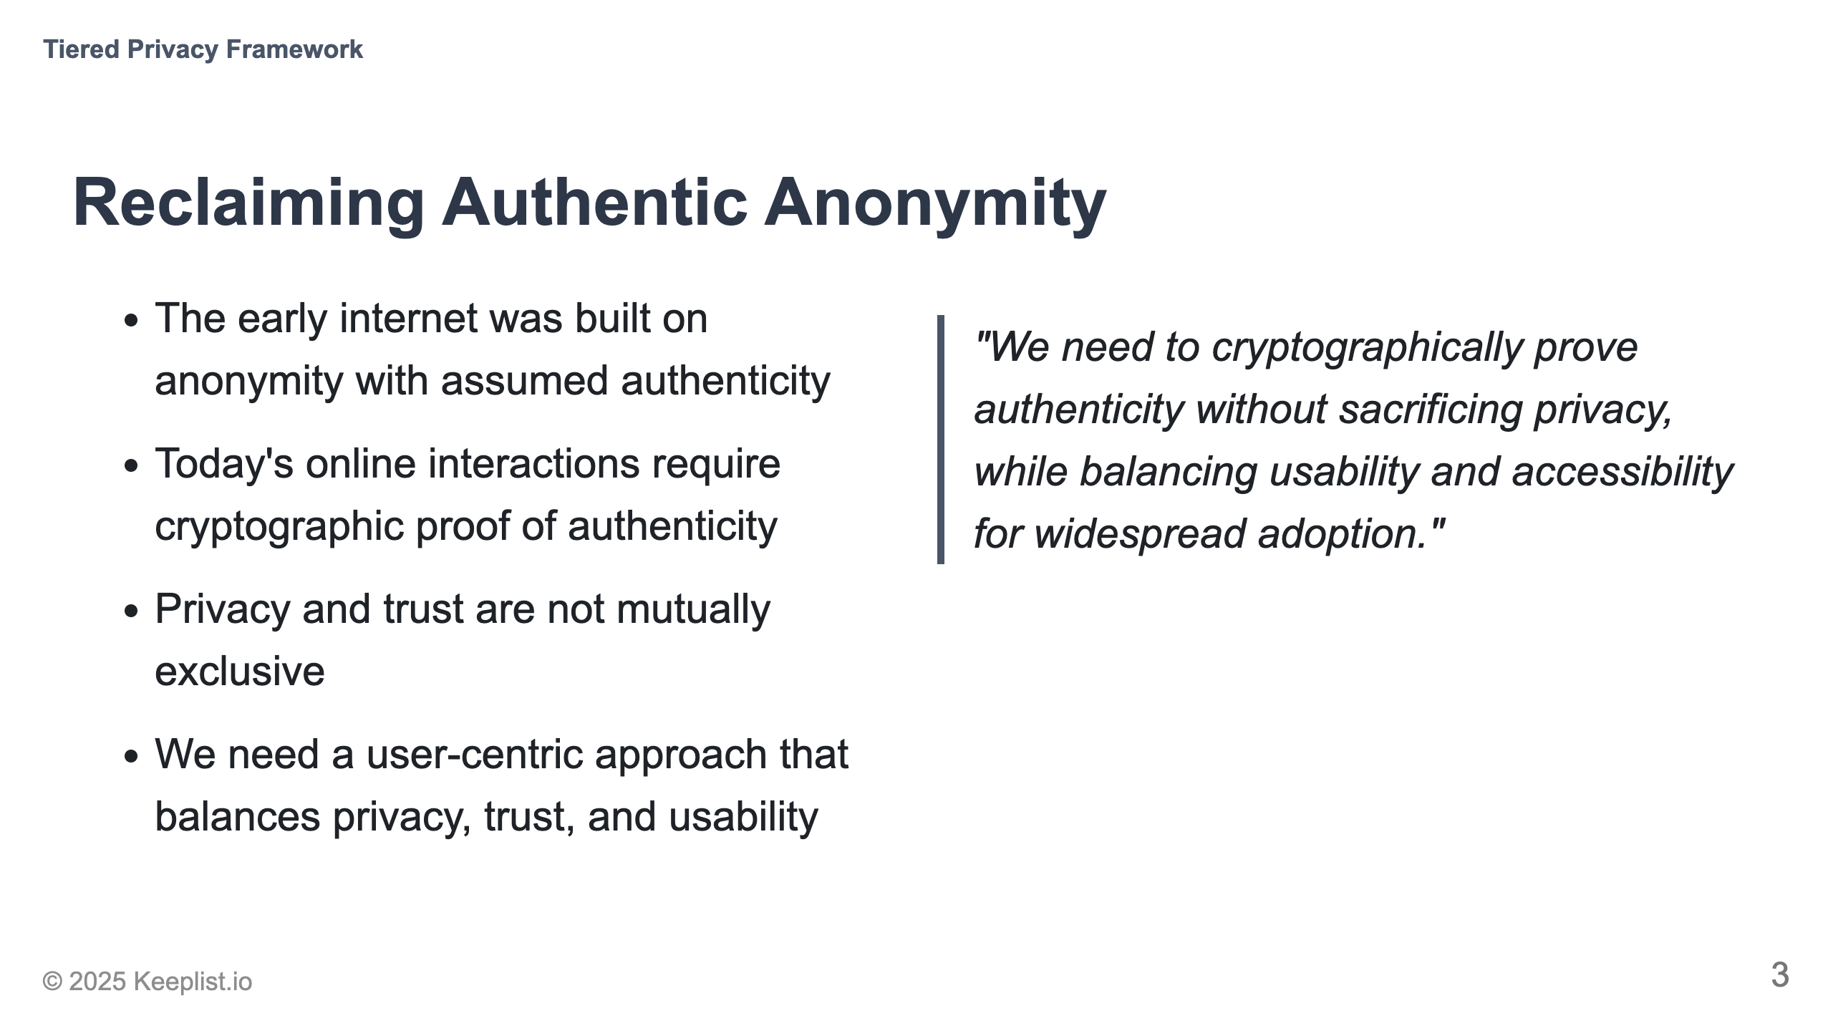

Slide 4
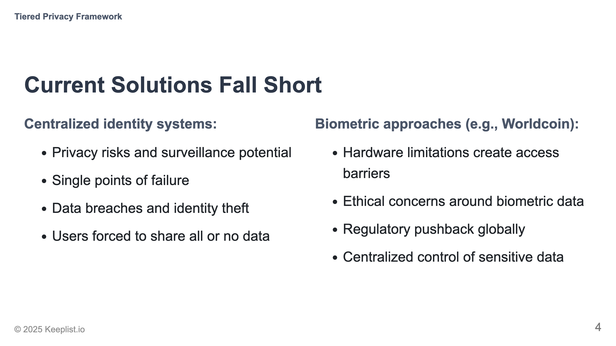

Slide 5
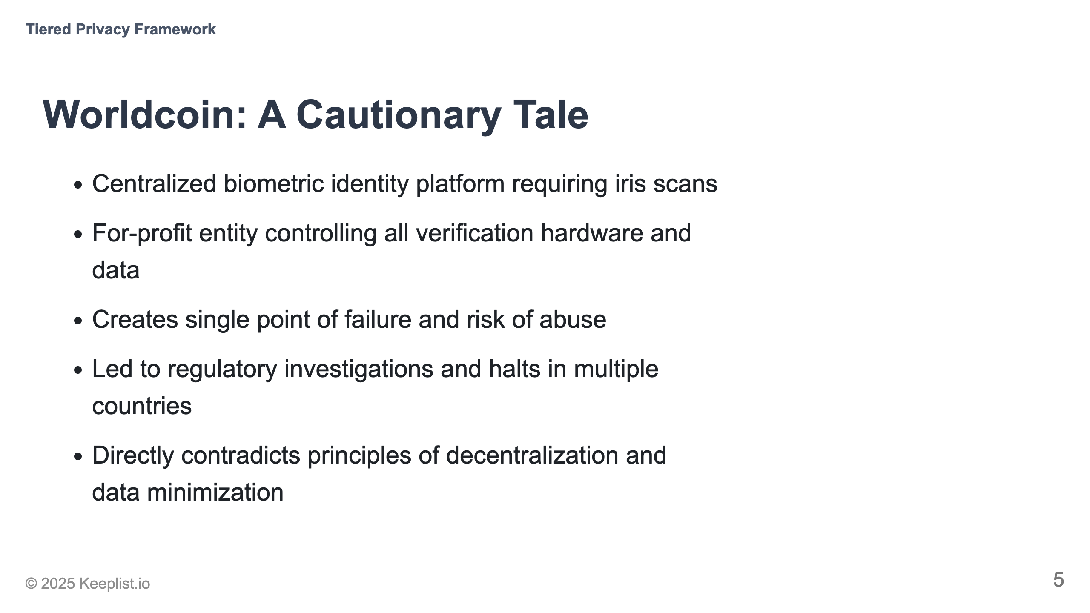

Slide 6
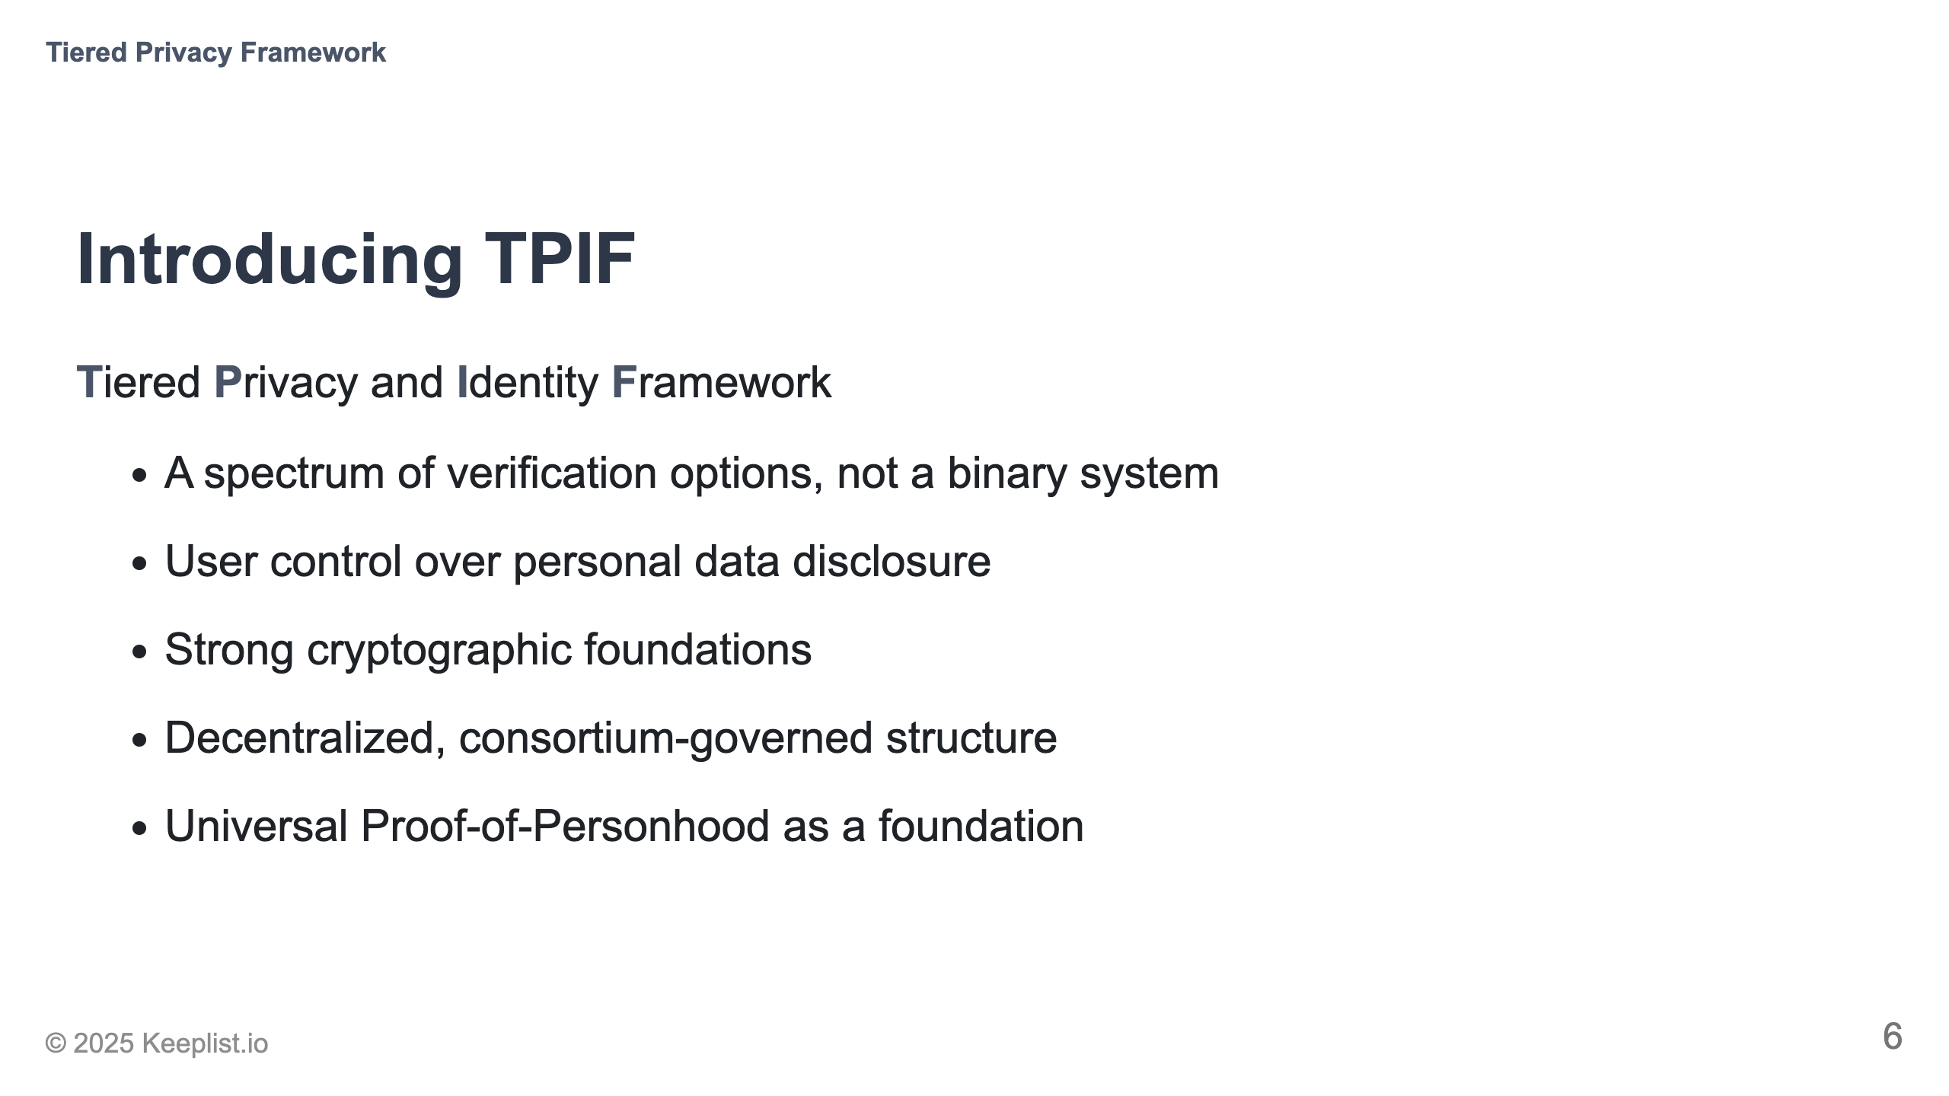

Slide 7
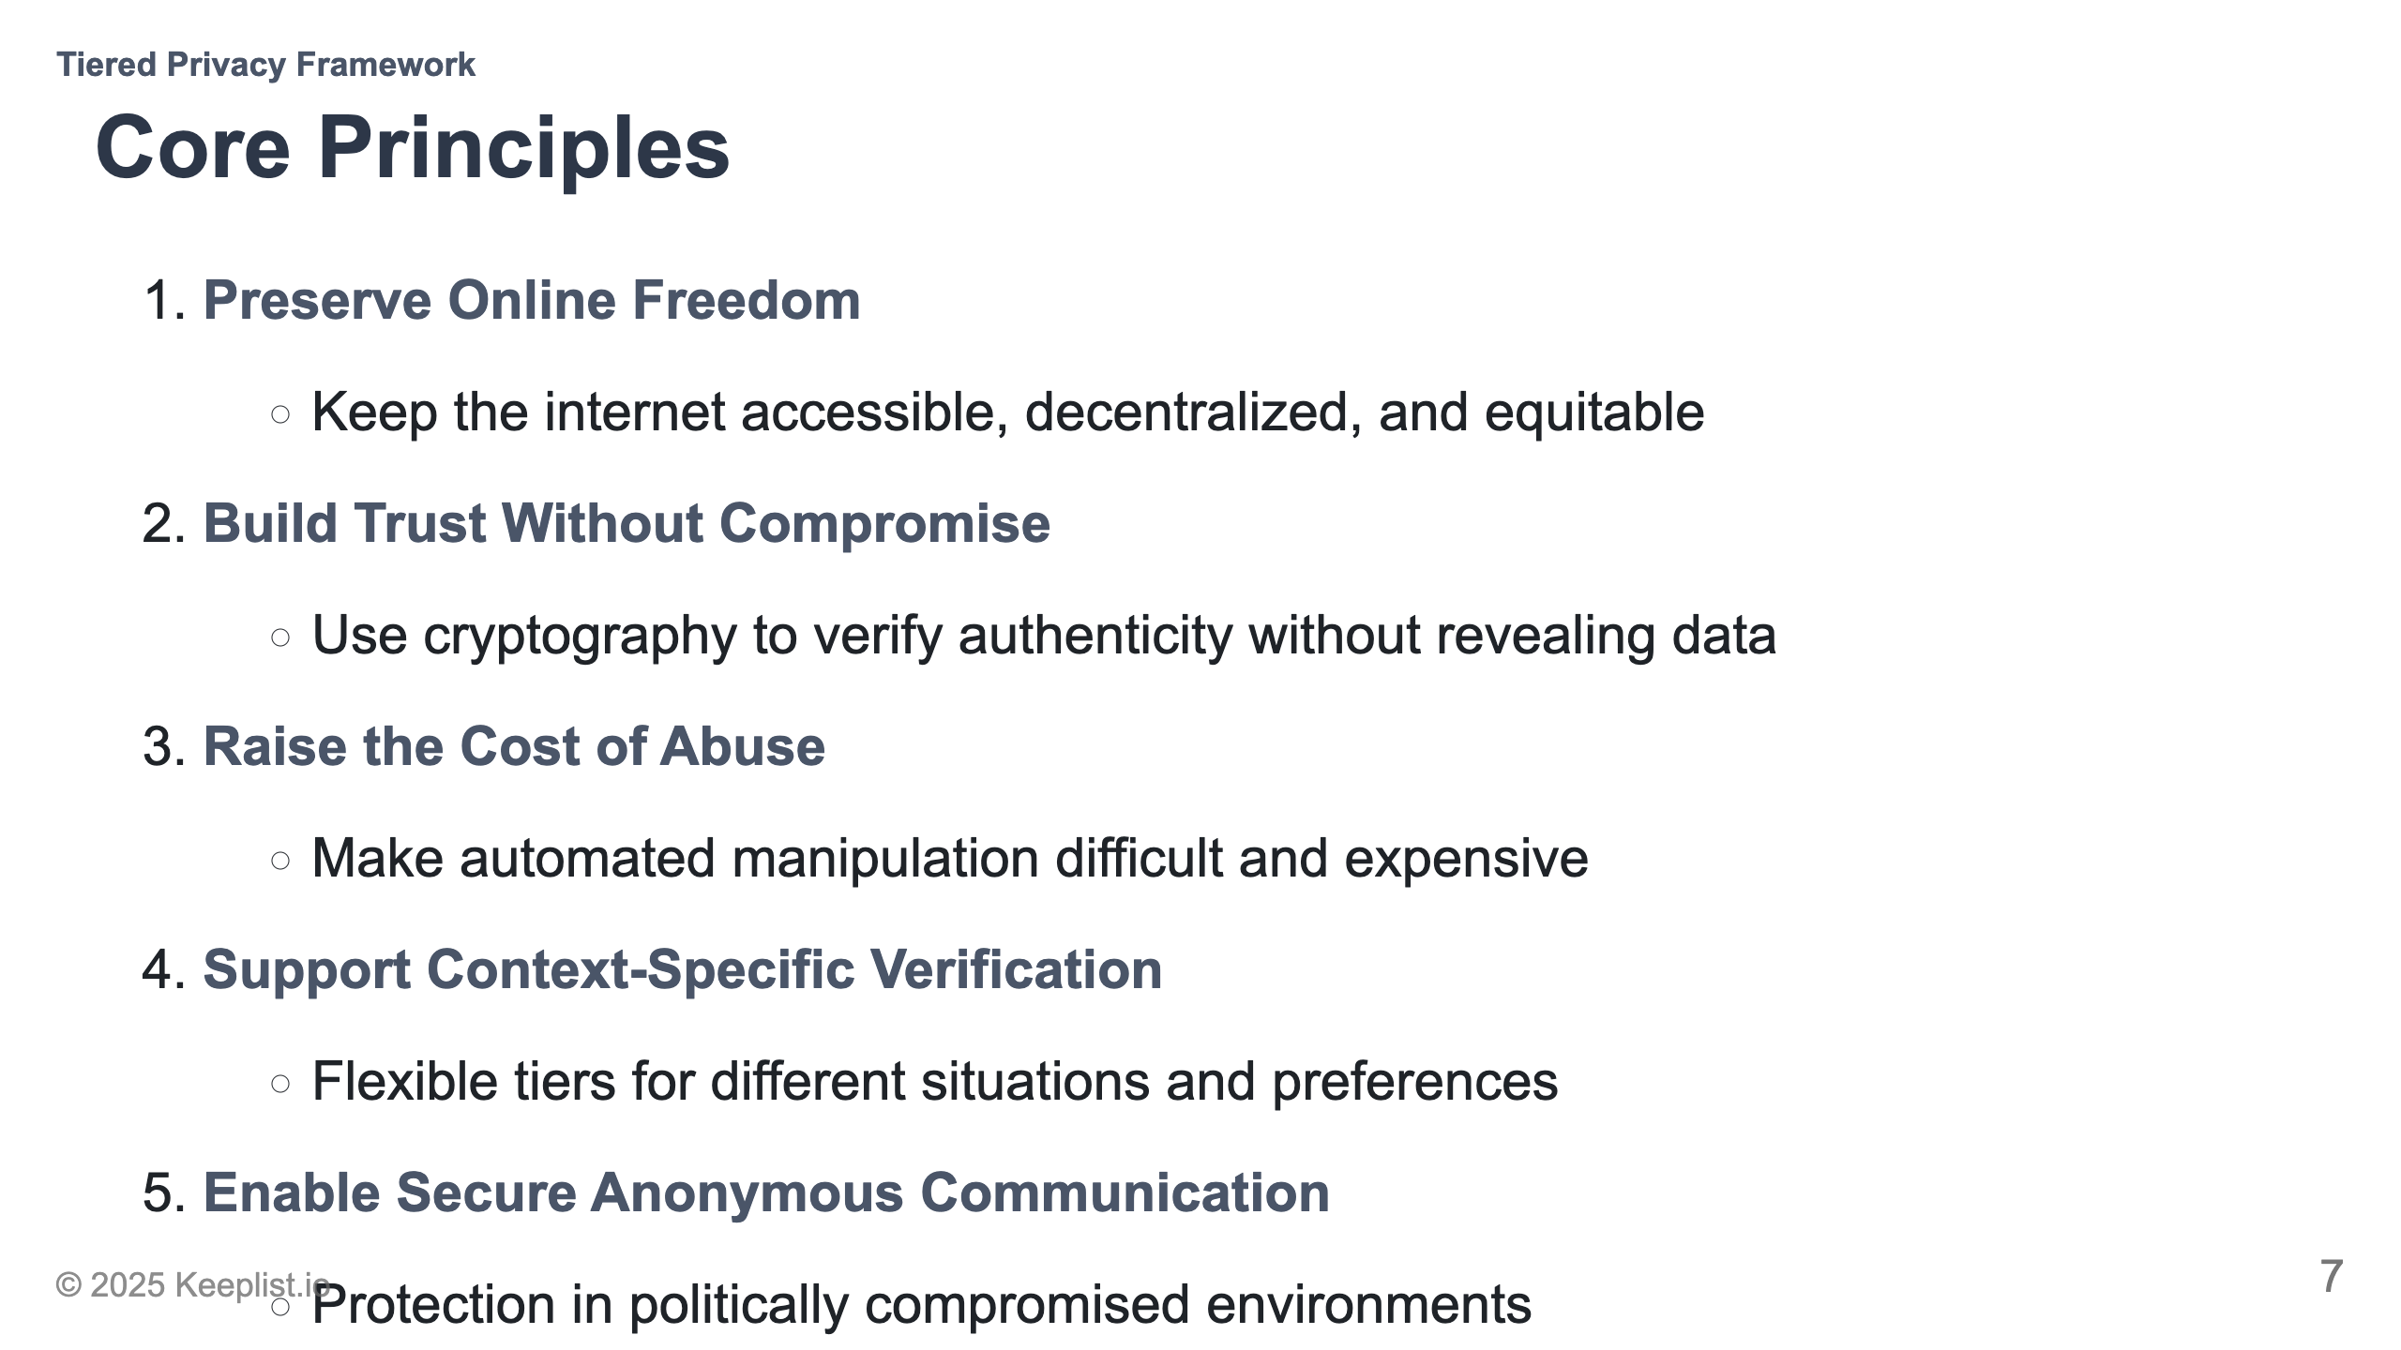

Slide 8
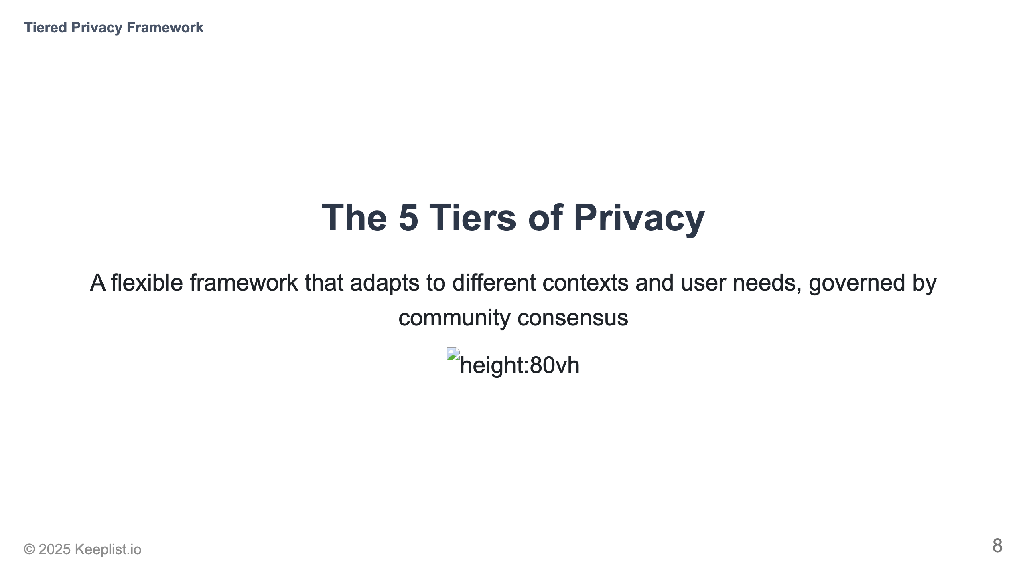
Notes:
Emphasize this is not a hierarchy but a spectrum of options

Slide 9
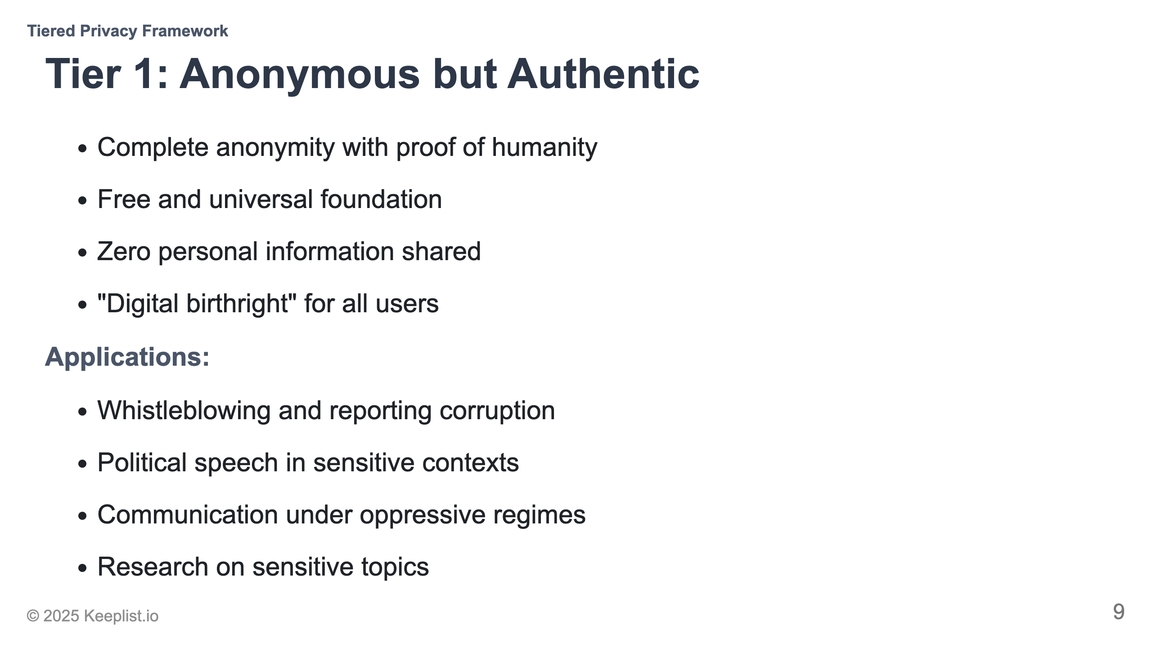
Notes:
Draw parallel to physical world: like being in a public square without ID

Slide 10
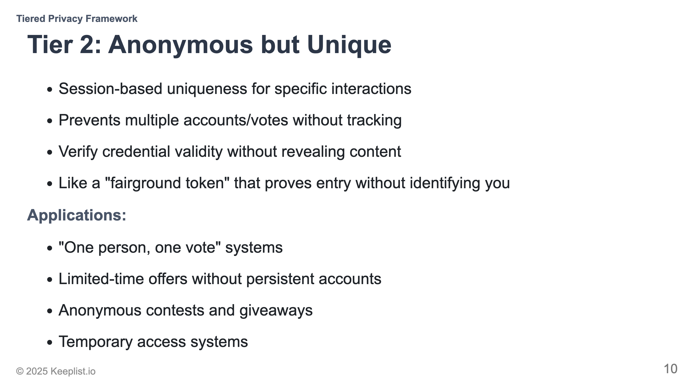
Notes:
Explain the "fairground token" analogy from the white paper

Slide 11
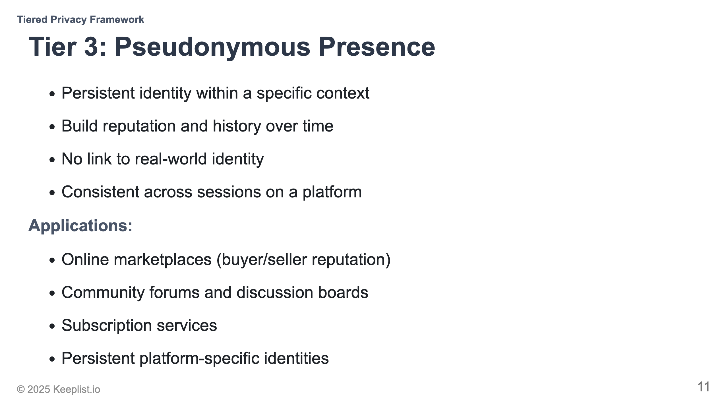
Notes:
Like having a username on Reddit or eBay

Slide 12
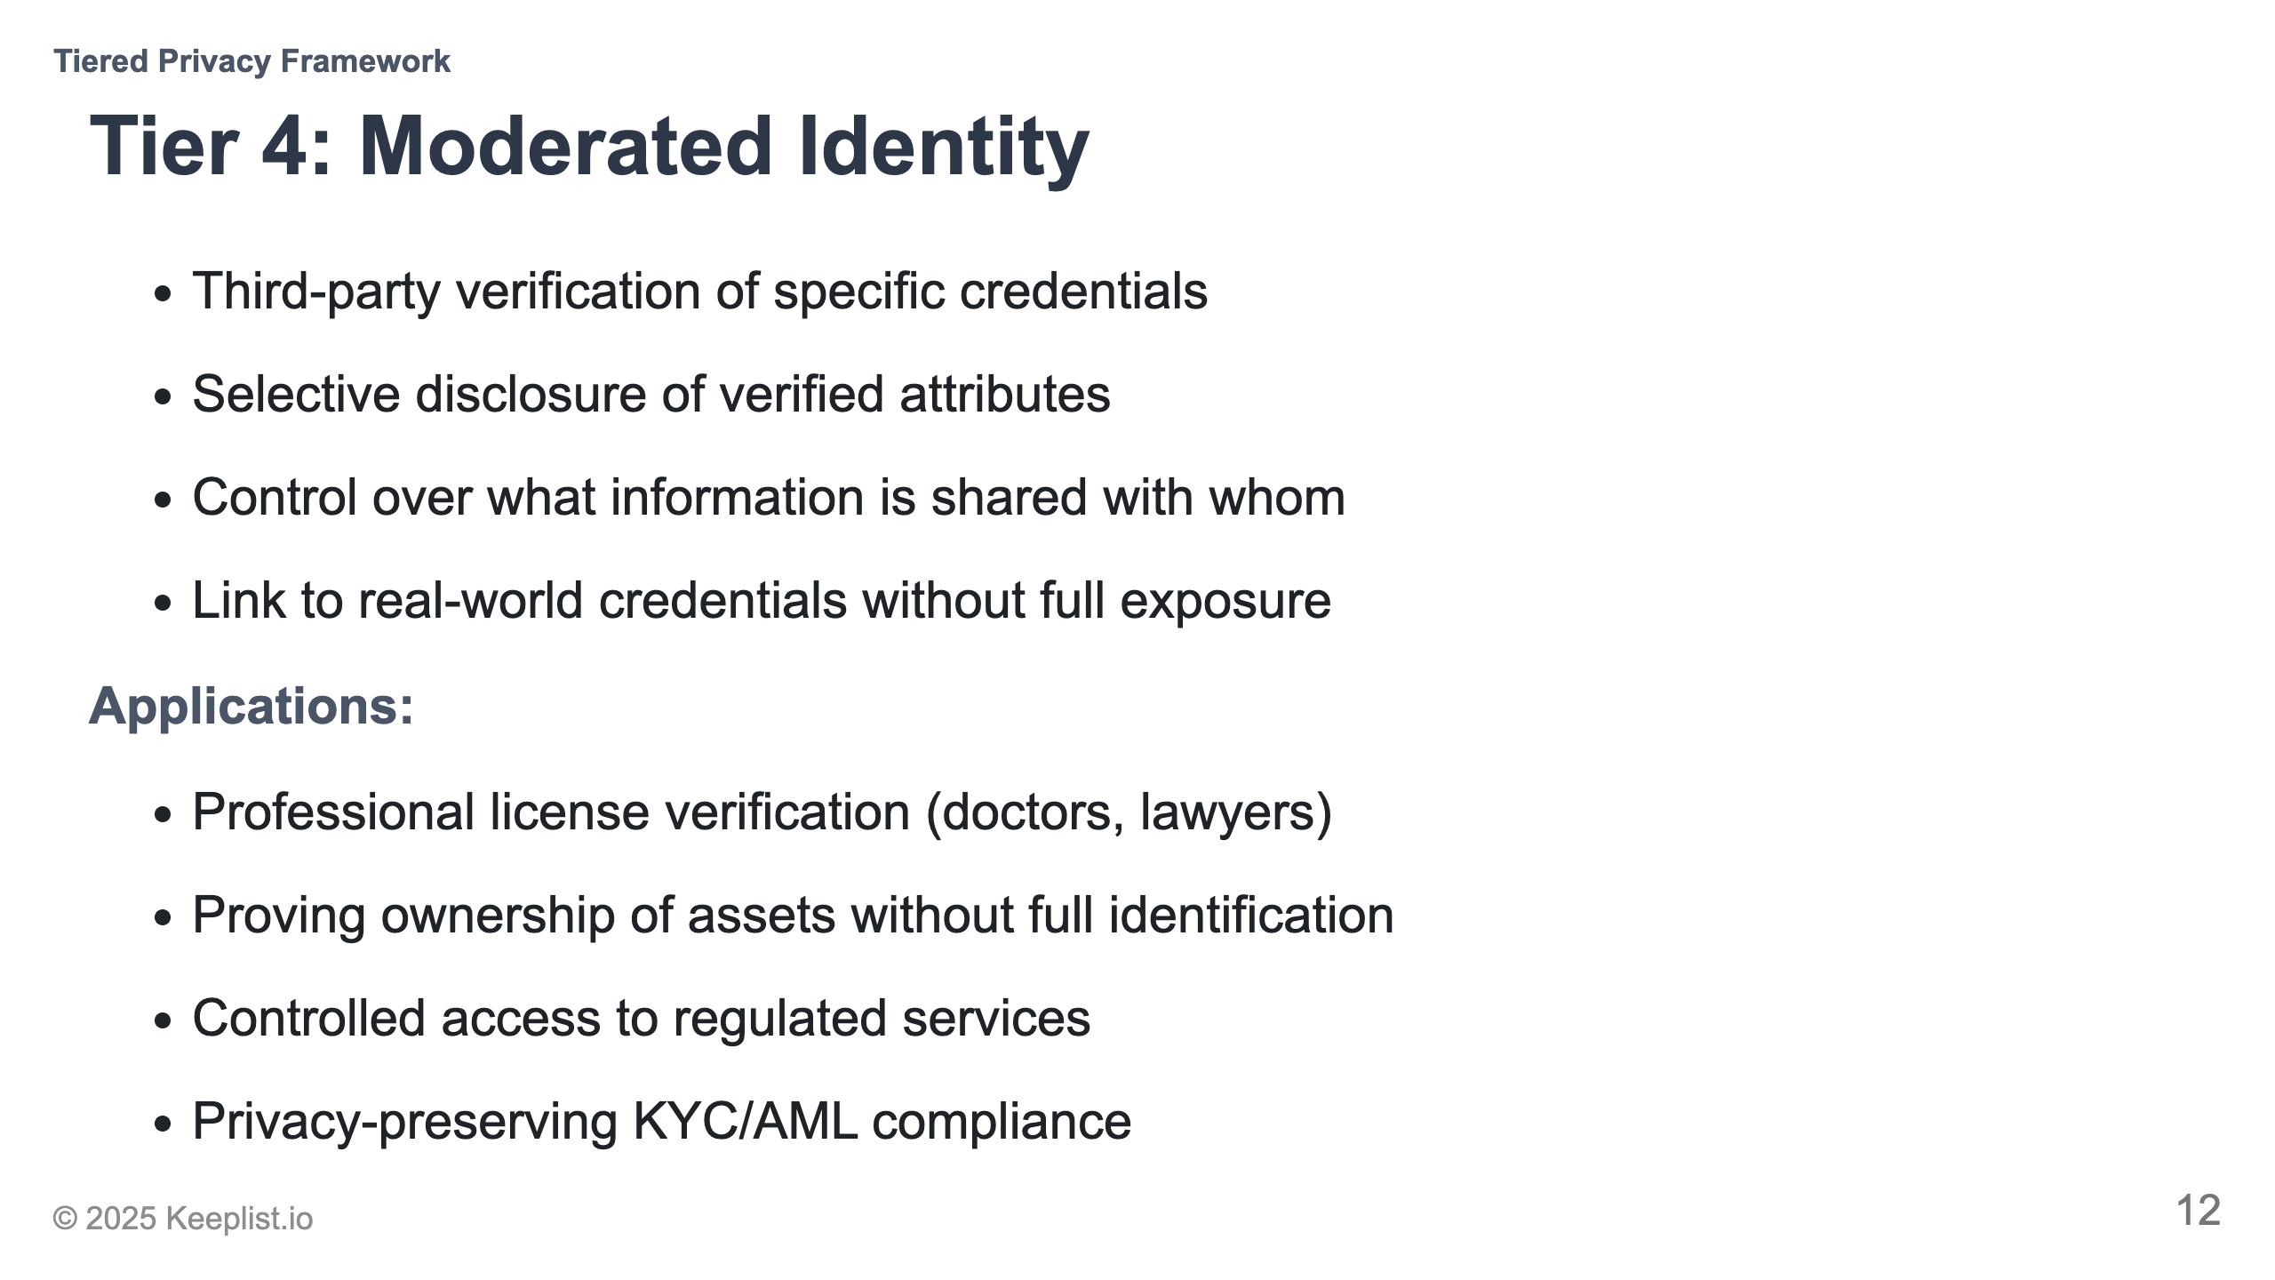
Notes:
Compare to showing just part of your driver's license

Slide 13
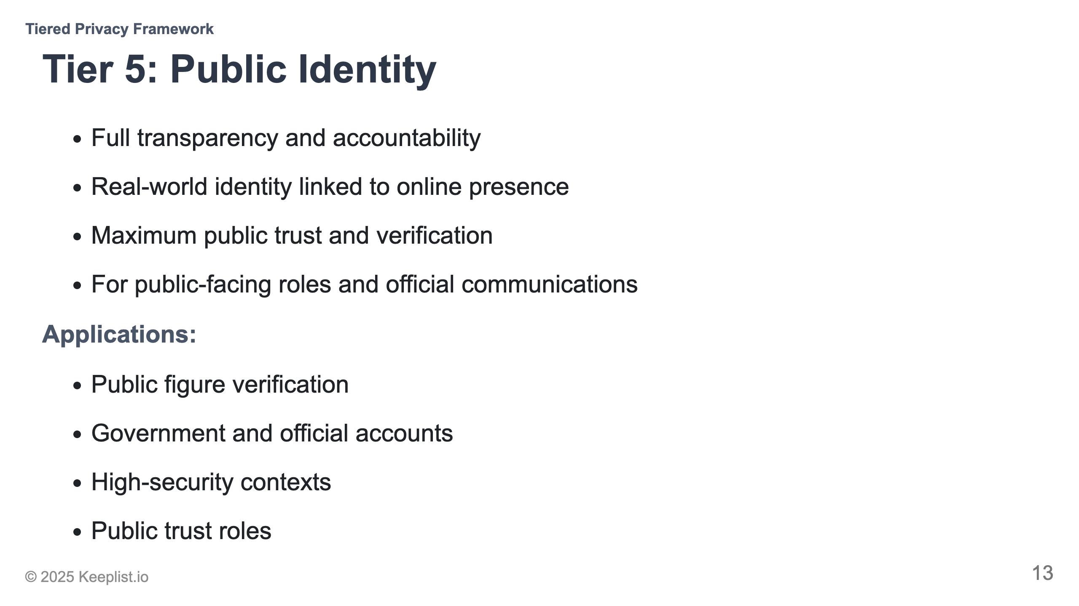
Notes:
Like having a public notarized identity

Slide 14
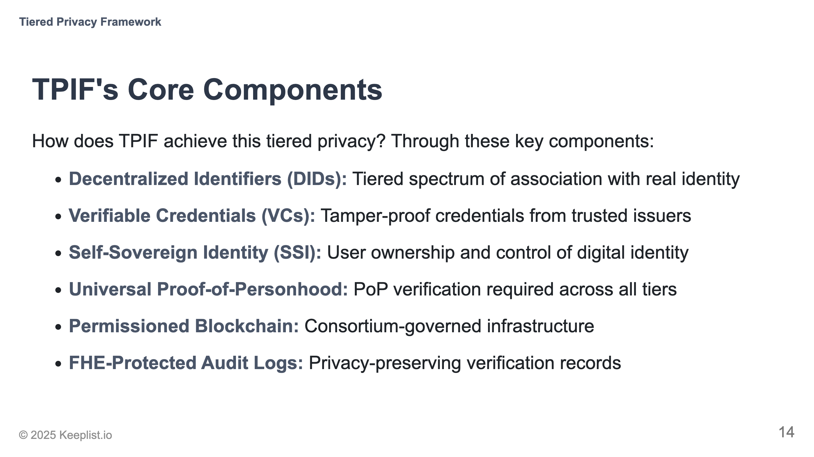
Notes:
Explain how these components work together

Slide 15
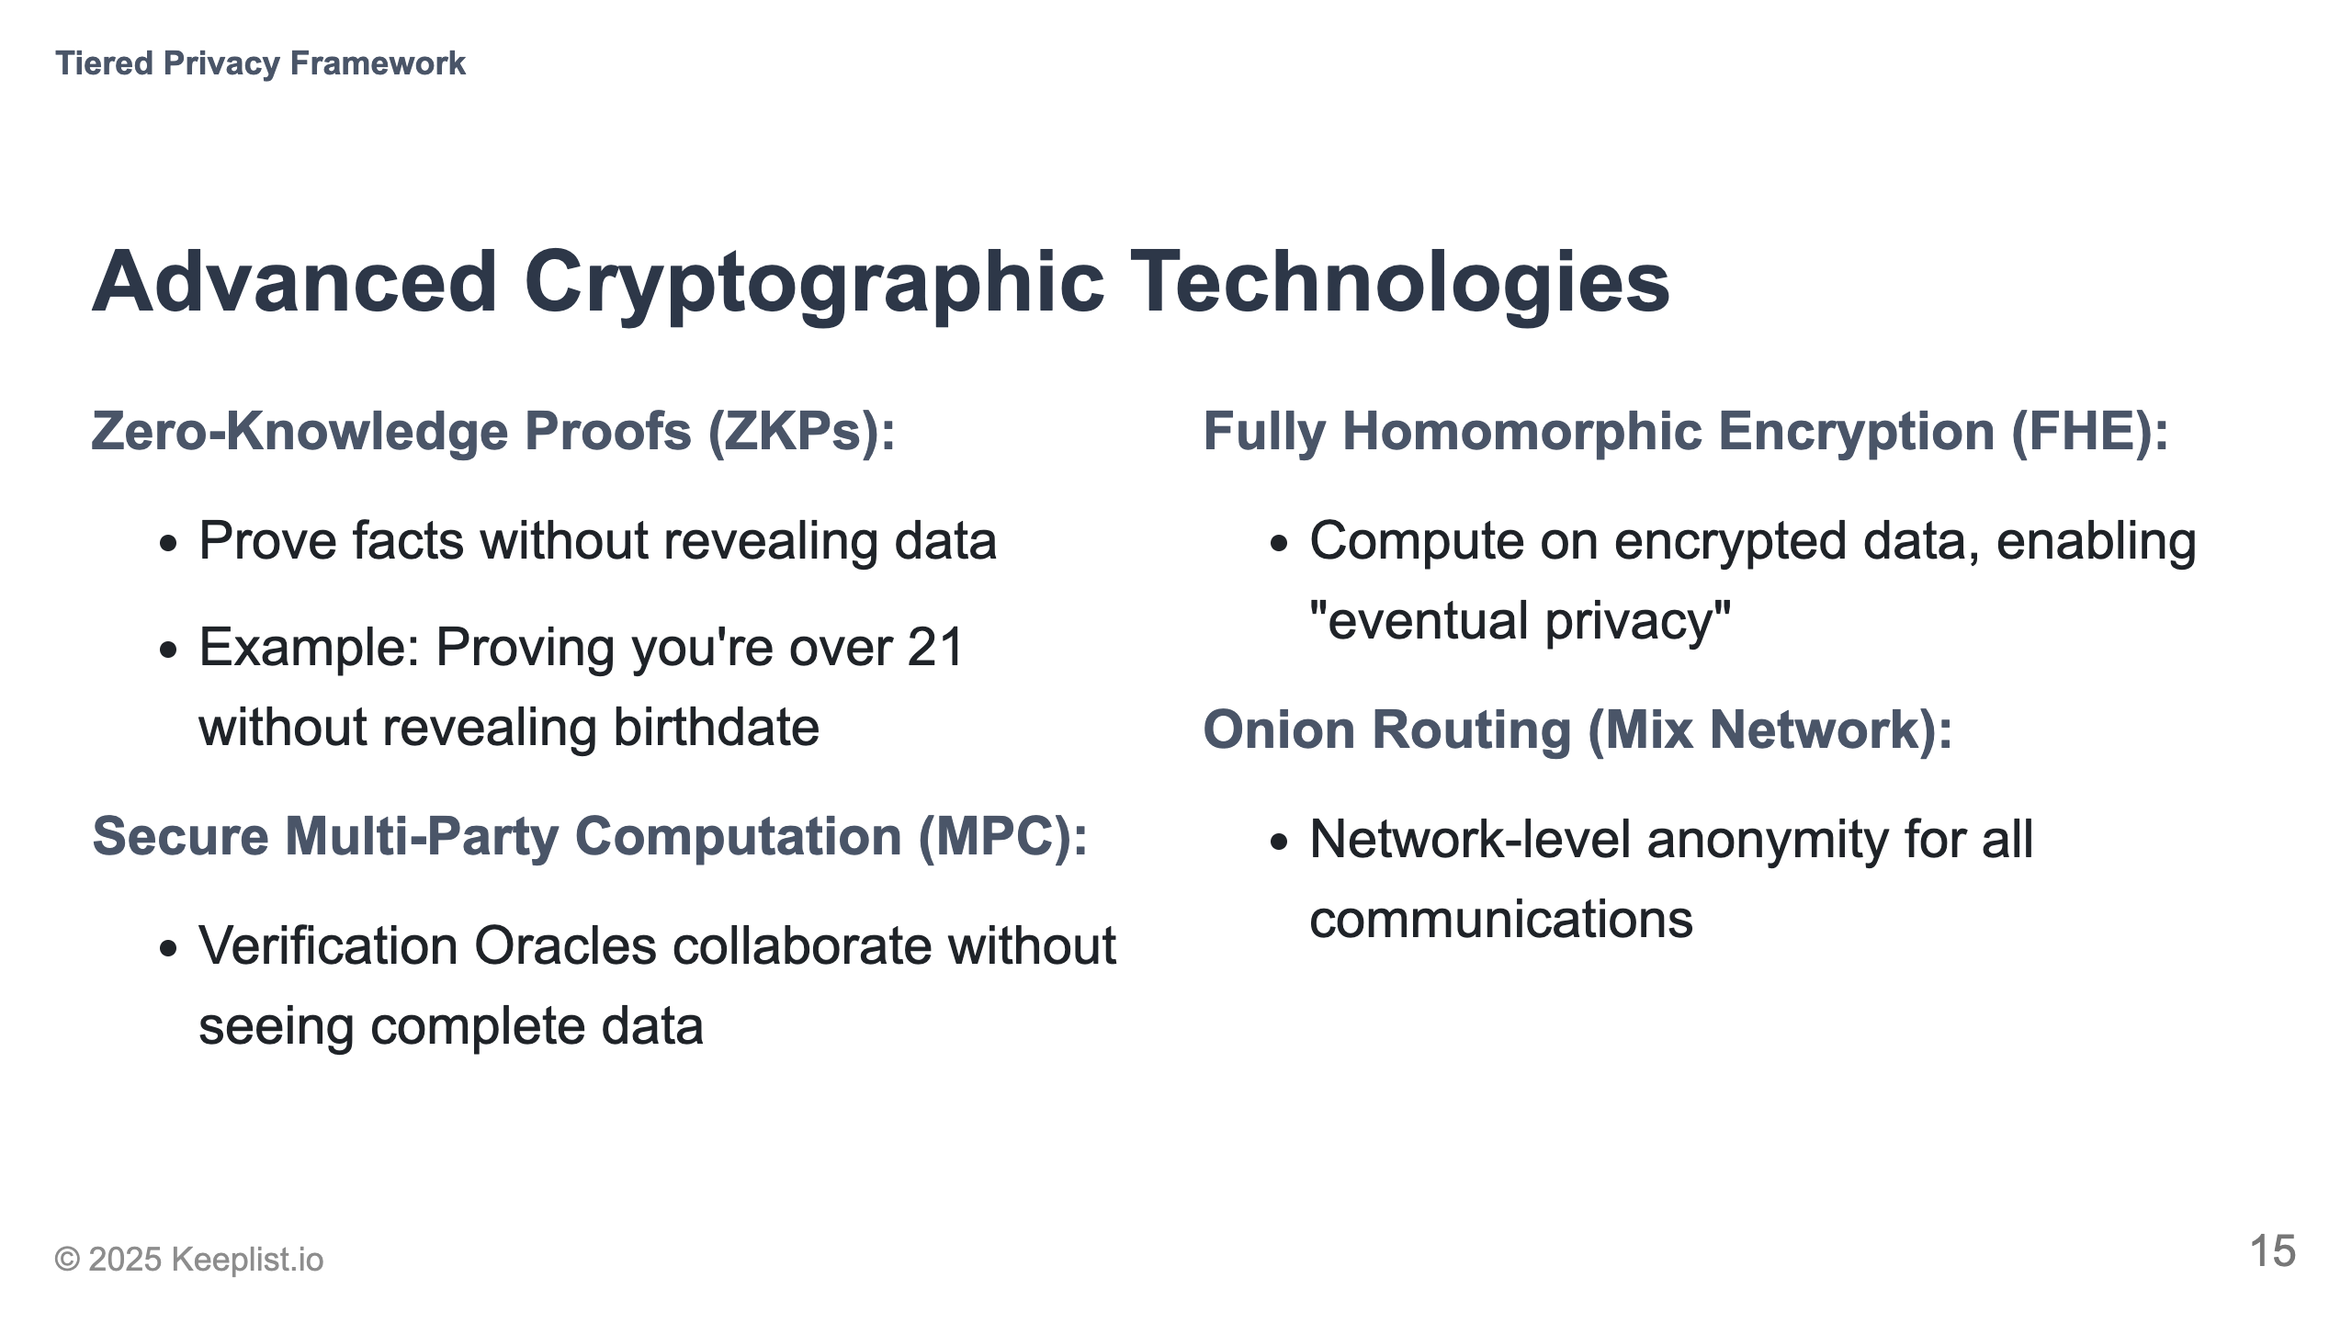
Notes:
Use analogies: ZKP is like proving you know a password without saying it

Slide 16
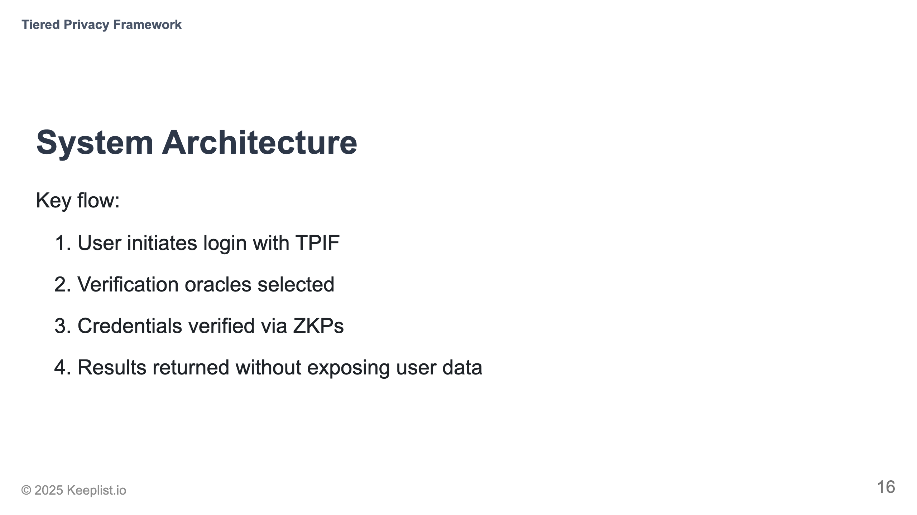
Notes:
Walk through the diagram following the login flow

Slide 17
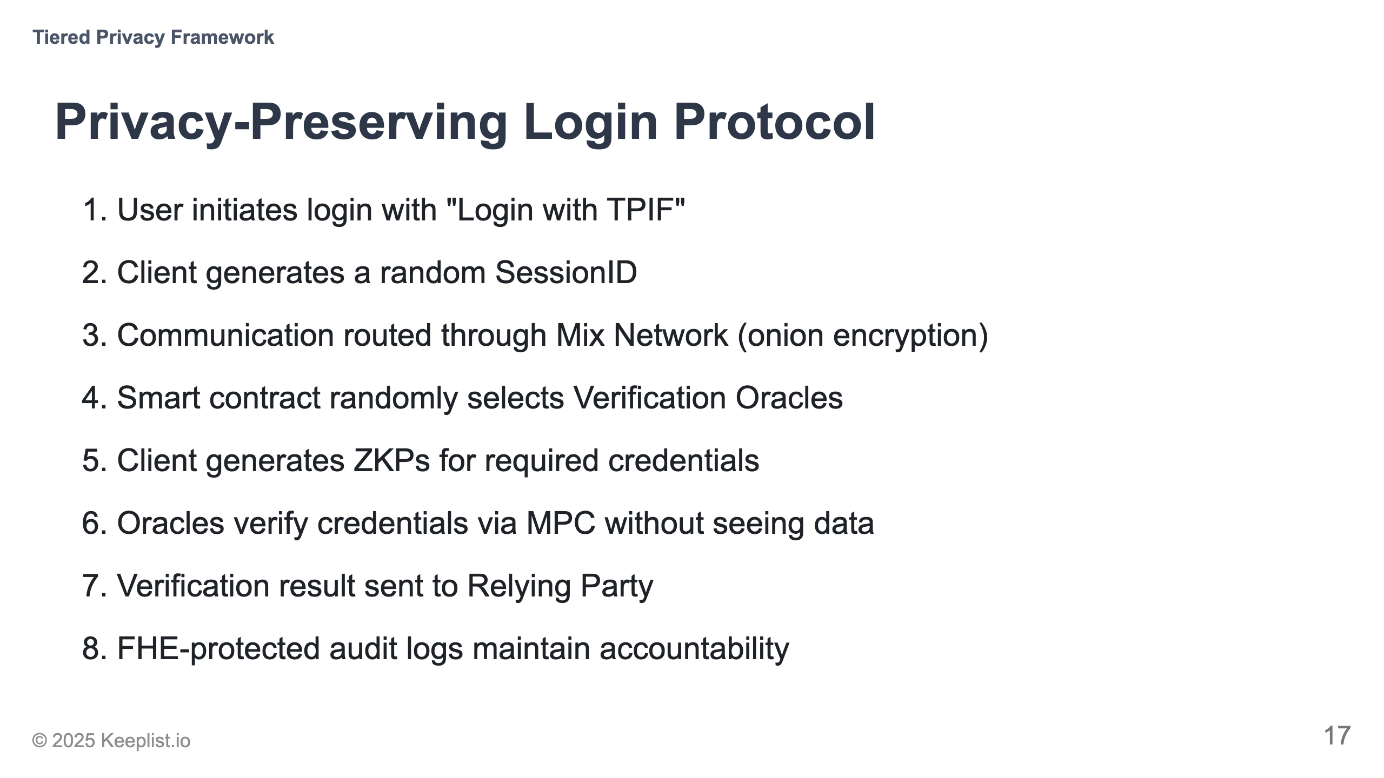
Notes:
Highlight that at no point is user data exposed to any single entity

Slide 18
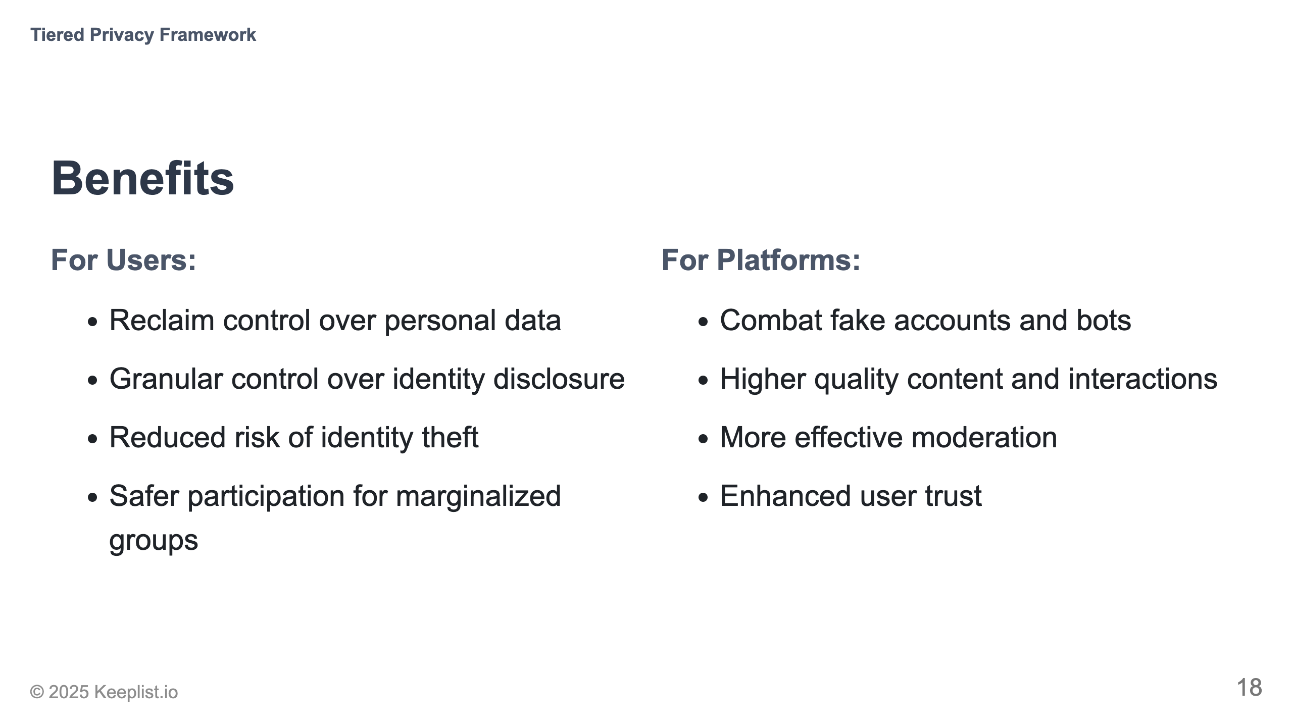
Notes:
Connect to specific current pain points each audience faces

Slide 19
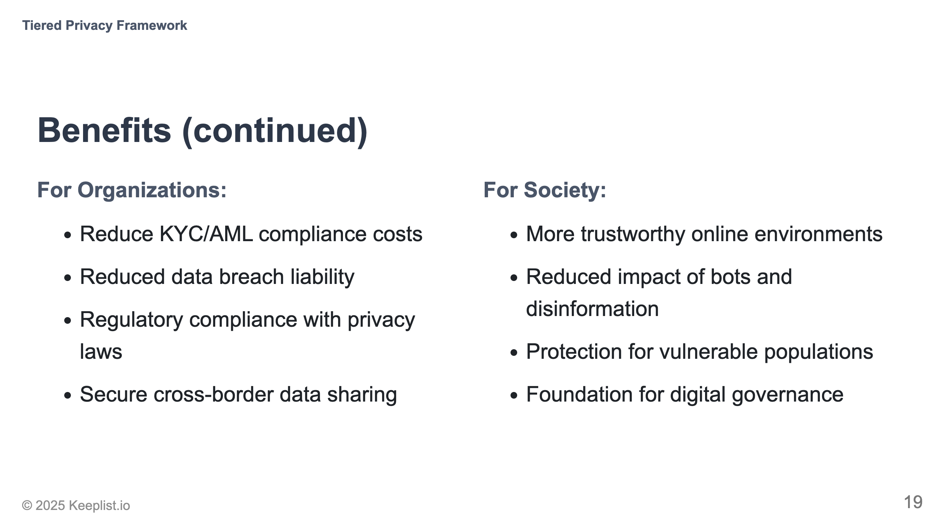

Slide 20
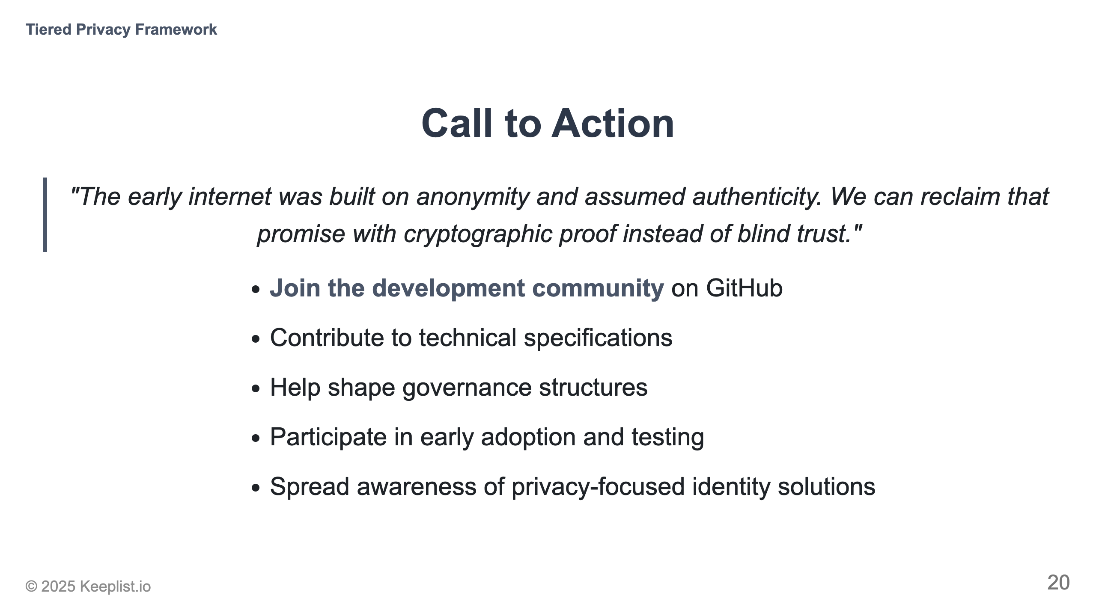
Notes:
Specific ways people can get involved today

Slide 21
